Slide 1
Towards Propagation Uncertainty: Edge-enhanced Bayesian Graph
Convolutional Networks for Rumor Detection
Lingwei Wei, Dou Hu, Wei Zhou, Zhaojuan Yue, Songlin Hu
Institute of Information Engineering, Chinese Academy of Sciences
National Computer System Engineering Research Institute of China
Computer Network Information Center, Chinese Academy of Sciences
School of Cyber Security, University of Chinese Academy of Sciences
ACL 2021
Code: https://github.com/weilingwei96/EBGCN
Zhuomin Chen
2021.12.05

Slide 2
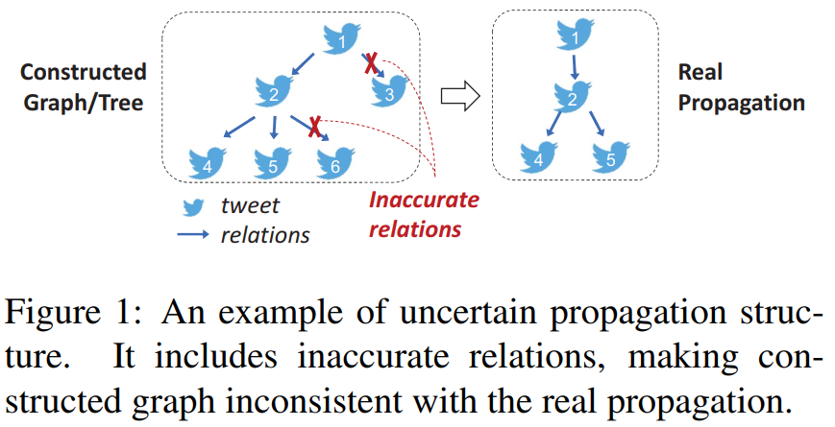
Introduction

Slide 3
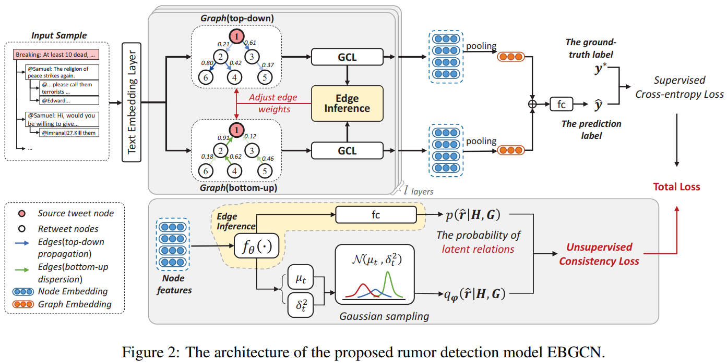

Slide 4
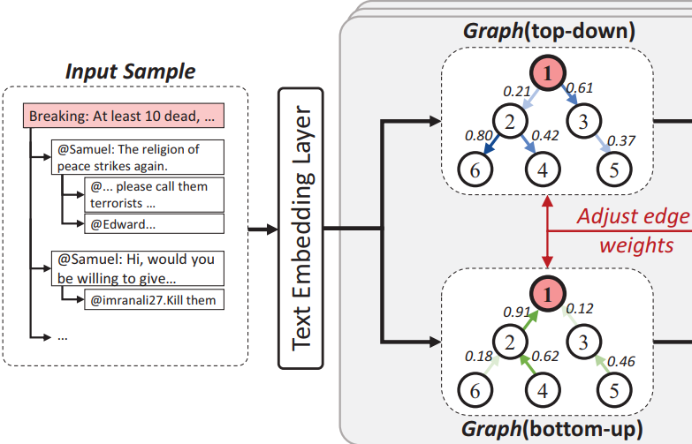
Rumor detection dataset:

Slide 5
Edge-enhanced Bayesian Graph Convolutional Networks
The top-down propagation graph and bottom-up dispersion graph:

Slide 6
Edge-enhanced Bayesian Graph Convolutional Networks
The supervised learning loss:

Slide 7
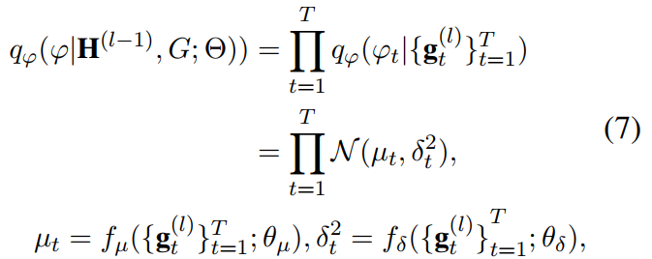
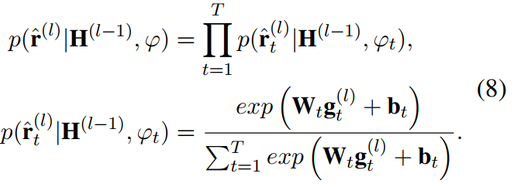
Edge-wise Consistency Training Framework
The unsupervised learning loss:
is the prediction distribution of latent relations

Slide 8
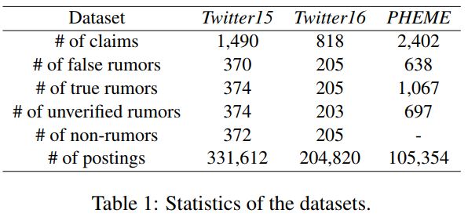
Experiments

Slide 9
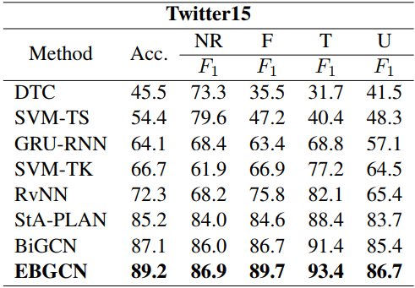
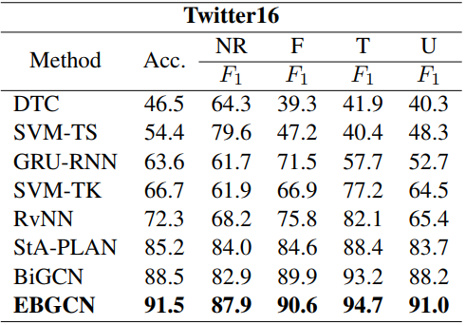
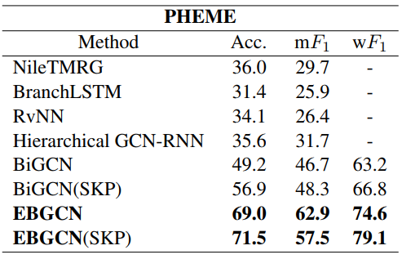

Slide 10
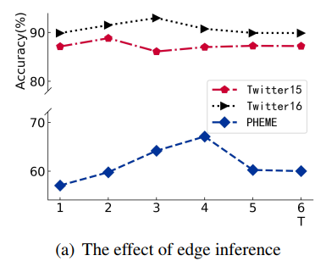
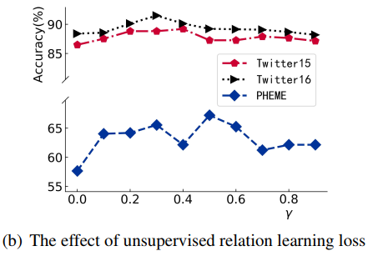
Model Analysis

Slide 11
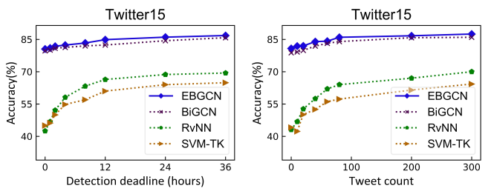
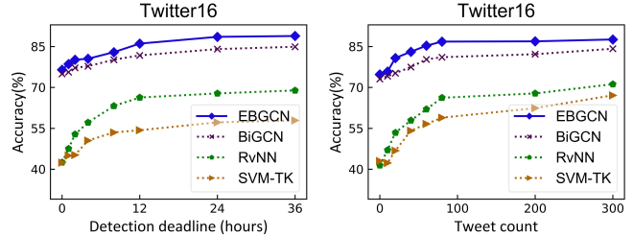
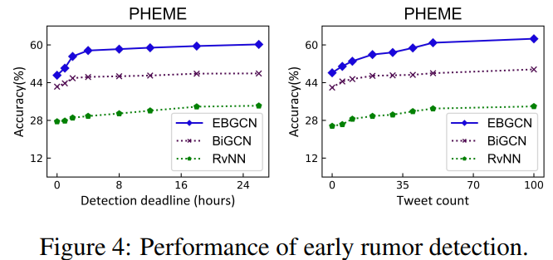
Early Rumor Detection

Slide 12
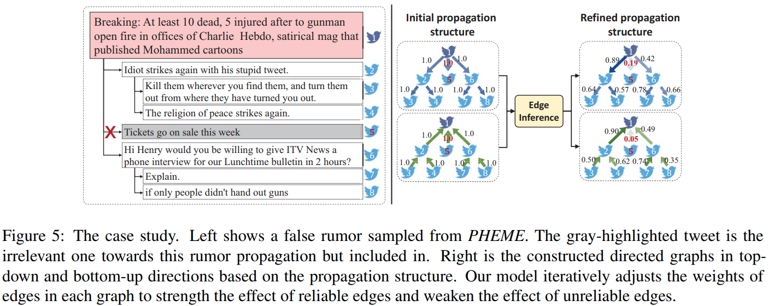
Case Study

